Slide 1
Optimizing SPB Level Number with Real GaN Devices
Project presentation: 1200 V DC-link, 300 kW three-phase inverter
Core question
How many stacked two-level cells are worth adding before device count and control overhead dominate?
Method
FOM screening + real off-the-shelf GaN database + first-order loss model
More cells
lower Vcell
better device FOM
more switches
Enes Ayaz | SPB inverter device-selection workflow

Slide 2
Why this optimization matters
SPB converts device voltage rating into a topology design variable.
System target
SPB opportunity
SPB penalty
• 1200 V DC-link
• 300 kW output power
• ≈ 291 A rms phase current
• high-frequency GaN switching
Stacked cells let each GaN device block only a fraction of the DC-link voltage, opening low-voltage GaN devices with lower RDS(on).
Each added cell brings six more switch positions, gate drivers, sensing, balancing, layout effort, and reliability questions.
Voltage stress
Device FOM
Loss & thermal
Complexity
The optimum is not simply the lowest-voltage device: it is the best balance of device FOM, conduction loss, switching loss, and implementation complexity.
Literature basis: X-FOM for device + topology optimization; SPBI/2L-SSC as stacked two-level converter concept.
Notes:
Use this slide to explain the optimization motivation. In the SPB topology, increasing levels is not free: it reduces device voltage stress but increases device count and control burden.

Slide 3
Literature basis translated to SPB
The project reuses published FOM and IMD design logic, but applies it to stacked polyphase bridge cells.
X-FOM paper
Optimal level-number paper
3L GaN vs 7L Si study
Device FOM alone is not enough. Device properties must be combined with topology, current, voltage, switching frequency, and number of levels.
More levels lower device blocking voltage and can reduce filter stress, but overhead increases; the optimum is not necessarily the maximum level count.
Real devices, overload limits, thermal spreading, and gate-driver volume can shift the practical optimum away from the ideal FOM result.
SPBI / 2L-SSC paper
IMMD literature survey
Takeaway for this project
Use FOM as a screening tool; then force the optimizer to use only real GaN voltage classes.
Stacked two-level cells avoid flying capacitors and can cancel common-mode voltage in a dual-winding motor, but require split DC-link and co-design.
Earlier IMMD work used GaN devices, interleaving, split windings, and modular control to reduce voltage stress and capacitor ripple.
Sources: Anderson et al. 2020; Rohner/Kolar/Bortis/Schweizer 2022; Rohner et al. IEEE Access 2024; Rohner/Huber/Mirić/Kolar Electronics 2024; IMMD survey.
Notes:
Mention that this is not yet a final design. It is an early project presentation showing how the method connects literature to the SPB concept.

Slide 4
Screening workflow implemented in MATLAB
Real device availability is treated as a hard constraint, not a continuous voltage variable.
1. Inputs
2. Database
3. Discrete levels
4. Loss model
VDC, Pout, pf, modulation, fsw, dv/dt, di/dt, safety factor
RDS(on), Coss, voltage rating, current rating, vendor/device
Cells = ceil(ks·VDC/Vdevice)
Levels = cells + 1
Pcond + ECoss + Eoverlap using dv/dt and di/dt
D-FOM = 1 / √(RDS(on) · Coss)
Eoverlap = Vcell · Isw · (Vcell/(dv/dt) + Isw/(di/dt))
ECoss = Coss,eq · Vcell²
Only realizable x-axis points are used: 650 V, 200 V, 150 V, 120 V, 100 V devices create different discrete SPB level counts.
This slide maps the X-FOM idea into the project-specific MATLAB implementation.

Slide 5
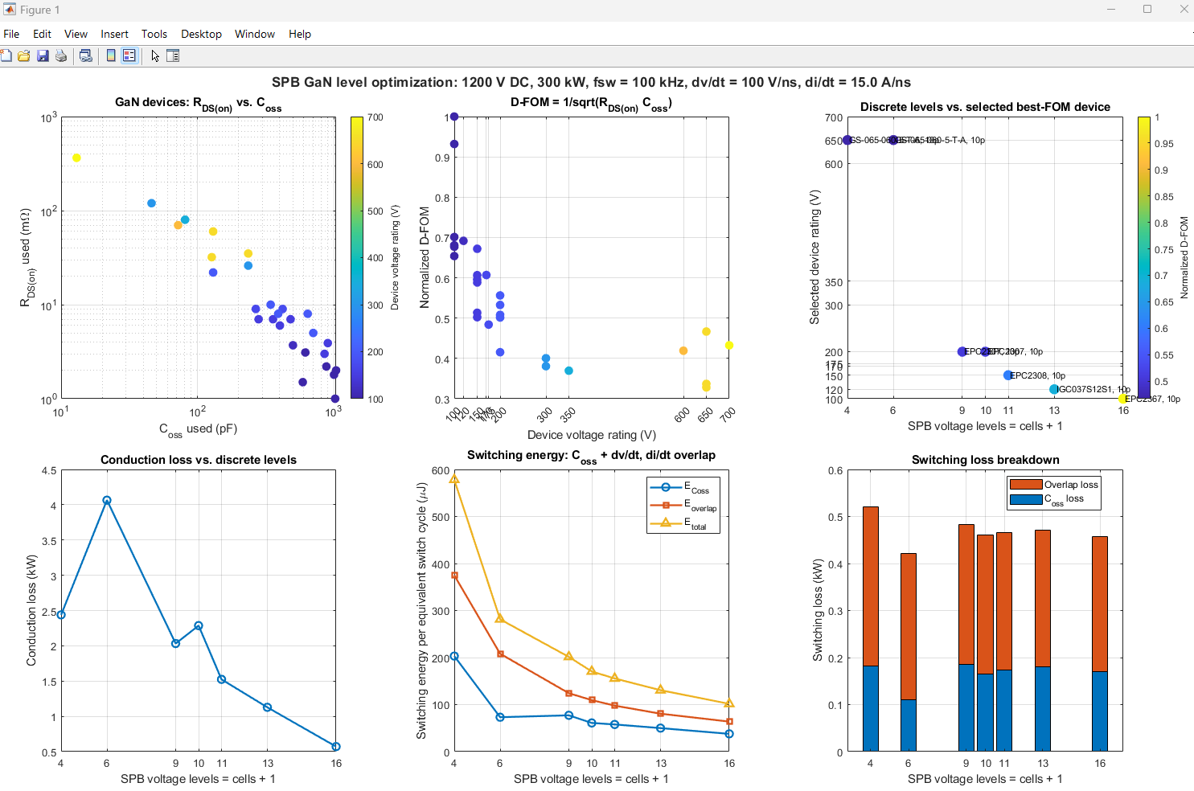
What are we looking at in the MATLAB graph?
The figure is a six-panel screening dashboard for device-level and topology-level decisions.
Top-left
Device database: lower-left is attractive, but voltage rating must be feasible.
Top-middle
D-FOM ranks devices by RDS(on)–Coss trade-off.
Top-right
Discrete level count chooses feasible best-FOM devices.
Bottom row
Separates conduction, switching energy, and switching-loss components.
Read it from left to right: device physics → FOM ranking → feasible SPB levels → loss mechanisms.
Notes:
This is the main explanation slide for the graph. Emphasize that the graph is not final efficiency prediction. It is a screening tool.

Slide 6
Device-level meaning: RDS(on), Coss, and D-FOM
The first two panels tell us which voltage classes are promising before topology penalties are added.
RDS(on) vs Coss
D-FOM vs voltage
Low voltage GaN often has excellent RDS(on), but its Coss can be large.
The optimum depends on current, voltage per cell, and switching frequency.
RDS(on)
D-FOM
D-FOM alone does not decide the design.
It only decides which devices deserve closer evaluation.
Better devices tend toward low RDS(on) and low Coss, but the voltage class determines whether they can be used in a given SPB level.
The current D-FOM is a normalized screening index: high value means good RDS(on)–Coss trade-off. In final work, Coss,Q or Eoss should replace simple Coss.
Interpretation
100–200 V devices look attractive, but only become feasible when enough cells are stacked.

Slide 7
Discrete levels: the x-axis is constrained by real device classes
We are not sweeping every possible level; we are only evaluating levels that correspond to available voltage ratings.
cells = ceil(ks · VDC / Vdevice,rated)
levels = cells + 1
650 V GaN
200 V GaN
100 V GaN
cells ≈ 3
levels ≈ 4
simple, mature
cells ≈ 9
levels ≈ 10
intermediate
cells ≈ 18
levels ≈ 19
with 1.5× margin
4
6
9
10
11
13
16
19
650 V
200 V
120 V
100 V
If we force 15 levels with 100 V GaN, the voltage margin is only about 100 / (1200/14) = 1.17×.
A safety-compliant 100 V case with ks = 1.5 requires about 19 levels.
This point mirrors the literature warning that ideal FOM results can change when only discrete commercial devices are available.

Slide 8
Loss model used for the screening graph
The model separates conduction, capacitive switching, and transient overlap losses.
Pcond = 3 · cells · Irms² · RDS(on)/npar
What it captures
Connection to papers
• higher cell count reduces Vcell
• lower-voltage devices reduce RDS(on)
• higher fsw amplifies switching energy
• dv/dt and di/dt affect VI overlap
The X-FOM paper first uses minimum capacitive hard-switching losses, then validates with measured switching losses. The 3L GaN / 7L Si paper uses fitted switching-energy coefficients and shows how overload thermal constraints become decisive.
ECoss = Coss,eq · Vcell²
What it still misses
Eoverlap = Vcell · Isw · (Vcell/(dv/dt) + Isw/(di/dt))
• measured Eon/Eoff per device
• dynamic RDS(on)
• thermal impedance
• layout inductance and overshoot
• DC-link capacitor ripple
Psw = 3 · cells · fsw · (ECoss + Eoverlap)
Next step: replace the generic overlap model with measured or datasheet-based Eon/Eoff for each candidate voltage class.

Slide 9
How to interpret the bottom-row plots
The optimum depends on which loss mechanism dominates at the chosen switching frequency.
Conduction loss
Switching energy
Switching loss
kW
µJ
kW
Conduction generally decreases as the optimizer accesses lower-RDS(on) devices and more parallel devices become feasible.
Switching energy falls with Vcell, but large Coss and paralleling can stop it from monotonically improving.
At high fsw, switching loss can become flat or dominant because every additional cell adds another switching stage.
Design implication
A low-voltage, many-cell SPB may reduce conduction loss, but it must win against switching loss, gate-drive loss, control complexity, and thermal packaging.

Slide 10
Suggested comparative study for the project
Mirror the style of the 3L GaN vs 7L Si FCi paper, but for SPB GaN voltage classes.
Case A: simple high-voltage SPB
Case B: aggressive low-voltage SPB
Case C: safety-compliant low-voltage SPB
Optional
650 V GaN
3 cells / 4 levels
Mature devices, low cell count
Lower sensing and gate-drive overhead
100 V GaN
14 cells / 15 levels
Only ≈1.17× voltage margin
Useful as a “what-if” compact-cell study
100 V GaN
18 cells / 19 levels
1.5× voltage margin
Best for fair design-margin comparison
200 V GaN
9 cells / 10 levels
Middle-ground baseline
Compare each case using the same current, fsw, thermal boundary, and modulation strategy.
Evaluation metrics
Semiconductor loss
conduction + Coss + measured/estimated Eon/Eoff
Complexity
switch positions, gate drivers, isolated supplies, sensors
Thermal feasibility
junction rise at nominal and overload current
DC-link / module capacitor
ripple current, energy storage, balancing control
Motor friendliness
voltage steps, CM voltage, winding stress, filtering need
Comparative-study inspiration: 3L GaN vs 7L Si FCi with overload operation and real hardware constraints.

Slide 11
Next-step model upgrades before final design selection
The present MATLAB graph is a screening layer; the final decision needs hardware-aware constraints.
1. Switching-loss data
2. Thermal model
3. DC-link / balancing
Build voltage-class models using measured/datasheet Eon/Eoff or fitted k0, k1, k2 coefficients.
Add Rth/Zth, baseplate spreading, dynamic RDS(on), and unequal sharing in parallel devices.
Include module capacitor ripple, midpoint dynamics, balancing controller limits, and fault states.
4. Layout parasitics
5. Motor co-design
6. Decision map
Power-loop inductance, gate-loop coupling, overshoot, EMI, and feasible package density.
Winding set count, insulation stress, CM cancellation, and harmonic loss.
Pareto front: efficiency, volume, complexity, thermal margin, device count, and manufacturability.
Recommended project deliverable
A two-stage optimizer: FOM + discrete devices first, then detailed electro-thermal-layout model for selected cases.

Slide 12
Key messages for the project presentation
The graph is a decision-support tool, not yet the final inverter design.
The useful SPB level count is governed by real GaN voltage classes, not by a continuous ideal voltage sweep.
Low-voltage GaN devices improve RDS(on), but many cells increase switch count and switching events.
The 650 V / 4-level case is a simple practical baseline; the 100 V / 15-level case is an aggressive low-voltage concept; the 100 V / 19-level case is the safety-compliant comparison.
Switching loss should be upgraded from generic dv/dt, di/dt overlap to measured Eon/Eoff or fitted energy coefficients.
The final SPB study should compare semiconductor loss, thermal feasibility, capacitor ripple, CM behavior, and implementation complexity.
Proposed headline comparison
650 V GaN, 3-cell SPB vs. 100 V GaN, 14-cell / 18-cell SPB

Slide 13
References used in this presentation
Papers provided today and the IMMD literature survey.
J. A. Anderson, G. Zulauf, J. W. Kolar, and G. Deboy, “New Figure-of-Merit Combining Semiconductor and Multi-Level Converter Properties,” IEEE Open Journal of Power Electronics, 2020.
G. Rohner, J. W. Kolar, D. Bortis, and M. Schweizer, “Optimal Level Number and Performance Evaluation of Si/GaN Multi-Level Flying Capacitor Inverter for Variable Speed Drive Systems,” ICEMS, 2022.
G. Rohner et al., “Comparative Evaluation of Three-Phase Three-Level GaN and Seven-Level Si Flying Capacitor Inverters for Integrated Motor Drives Considering Overload Operation,” IEEE Access, 2024.
G. Rohner, J. Huber, S. Mirić, and J. W. Kolar, “Comparative Evaluation of Three-Phase Three-Level Flying Capacitor and Stacked Polyphase Bridge GaN Inverter Systems for Integrated Motor Drives,” Electronics, 2024.
M. Uğur, “Literature Survey for Integrated Modular Motor Drives,” presentation, 2018.
Note: Values in the MATLAB graph are screening-level estimates and must be replaced by verified device measurements for publication-quality results.

